Slide 1
Model-code synchronization for interaction component

Slide 2
Code generation
Code generation template
Use
Model
Code generation
Code

Slide 3
Evolution
Model
Code generation template T
Code
Modify
Modify
Modify
Model’
T’
Code’
Model’
Consistency?
Code’

Slide 4
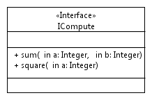
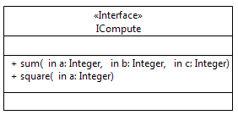
Motivating example
public def marshall(Operation op) {
'''
int size = 0;
«FOR p:op.InOutParameters»
{
«p.type.cppType» varName_ASN = «p.name»;
BEncAsnContent(&pBuffer, &varName_ASN);
size += sizeof(«p.name»);
}
«ENDFOR»
send(pBuffer, size);
'''
}
Template T
Generated code C
int sum(int a, int b) {
int size;
{
int varName = a;
BEncAsnContent(&pBuffer, &varName);
size += sizeof(a);
}
{
int varName = b;
BEncAsnContent(&pBuffer, &varName);
size += sizeof(b);
}
send(pBuffer, size);
}
Use template T
Code generation
Modify
Modify
Modify
/*non generated*/
int sum(int a, int b) {
int size;
{
int varName = a;
BEncAsnContent(&pBuffer, &varName);
size += sizeof(a);
}
{
int varName = b;
BEncAsnContent(&pBuffer, &varName);
size += sizeof(b);
}
size = size + 5;
send(pBuffer, size);
}
Generated code C
Template T
public def marshall(Operation op) {
'''
int size = 0;
«FOR p:op.InOutParameters»
{
«p.type.cppType» varName_ASN = «p.name»;
AnsiMarshall(&pBuffer, &varName_ASN);
size += sizeof(«p.name»);
}
«ENDFOR»
send(pBuffer, size);
'''
}

Slide 5
Existing approaches
Preseve model + template changes
Code generation with modified model + template to Code’’
Overwrite changes previously made to Code’
Code generation template T’
Use
Model’
Code generation
Code’’
public def marshall(Operation op) {
'''
int size = 0;
«FOR p:op.InOutParameters»
{
«p.type.cppType» varName_ASN = «p.name»;
AnsiMarshall(&pBuffer, &varName_ASN);
size += sizeof(«p.name»);
}
«ENDFOR»
send(pBuffer, size);
'''
}
int sum(int a, int b, int c) {
int size;
{
int varName = a;
AnsiMarshall(&pBuffer, &varName);
size += sizeof(a);
}
{
int varName = b;
AnsiMarshall(&pBuffer, &varName);
size += sizeof(b);
}
{
int varName = c;
AnsiMarshall(&pBuffer, &varName);
size += sizeof(c);
}
send(pBuffer, size);
}

Slide 6
Existing approaches
Preseve code changes
Generated code Code’ is tagged by @generated/@protected
public def marshall(Operation op) {
'''
int size = 0;
«FOR p:op.InOutParameters»
{
«p.type.cppType» varName_ASN = «p.name»;
BEncAsnContent(&pBuffer, &varName_ASN);
size += sizeof(«p.name»);
}
«ENDFOR»
send(pBuffer, size);
'''
}
Template T
/*non generated*/
int sum(int a, int b) {
int size;
{
int varName = a;
BEncAsnContent(&pBuffer, &varName);
size += sizeof(a);
}
{
int varName = b;
BEncAsnContent(&pBuffer, &varName);
size += sizeof(b);
}
send(pBuffer, size);
}
Generated code C
Use template T
Code generation
Code generation after changes made to the artifacts
/*non generated*/
int sum(int a, int b) {
int size;
{
int varName = a;
BEncAsnContent(&pBuffer, &varName);
size += sizeof(a);
}
{
int varName = b;
BEncAsnContent(&pBuffer, &varName);
size += sizeof(b);
}
size = size + 5;
send(pBuffer, size);
}
-The “old sum” is preserved but dead-code since the signature is not met with the model-defined operation
-Potential to have syntax errors since no “sum” method in code is met with the model’s.

Slide 7
Overview of our approach
/*non generated*/
int sum(int a, int b) {
int size;
{
int varName = a;
BEncAsnContent(&pBuffer, &varName);
size += sizeof(a);
}
{
int varName = b;
BEncAsnContent(&pBuffer, &varName);
size += sizeof(b);
}
size = size + 5;
send(pBuffer, size);
}
Generated code C
Template T
public def marshall(Operation op) {
'''
int size = 0;
«FOR p:op.InOutParameters»
{
«p.type.cppType» varName_ASN = «p.name»;
AnsiMarshall(&pBuffer, &varName_ASN);
size += sizeof(«p.name»);
}
«ENDFOR»
send(pBuffer, size);
'''
}
//@non generated
int sum(int a, int b, int c) {
int size;
{
int varName = a;
AnsiMarshall(&pBuffer, &varName);
size += sizeof(a);
}
{
int varName = b;
AnsiMarshall(&pBuffer, &varName);
size += sizeof(b);
}
{
int varName = c;
AnsiMarshall(&pBuffer, &varName);
size += sizeof(c);
}
size = size + 3;
send(pBuffer, size);
}
Synchronizer

Slide 8
Overview of our approach
T
Match
use
C
Model
CT
T’
Diff1
Diff2
modify
use
CU
Model’
CT’
Synchronizer

Slide 9
Four-way merging
Match and diff
Match: maintaining line-based matches between the previous generated code CT and the previous synthesized code C
Diff1: maintaining the differences between the previous generated code CT and the generated code CT’ after models and templates modifications
Diff2: maintaining the differences between the previous synthesized code C and the modified code C’.
Match and diff format:
A match m in Match consists of left lines (ll) and right lines (rl). ll are lines of CT which are matched with rl lines of C.
CT
C
int sum(int a, int b) {
int size;
{
int varName = a;
BEncAsnContent(&pBuffer, &varName);
size += sizeof(a);
}
{
int varName = b;
BEncAsnContent(&pBuffer, &varName);
size += sizeof(b);
}
send(pBuffer, size);
}
/*non generated*/
int sum(int a, int b) {
int size;
{
int varName = a;
BEncAsnContent(&pBuffer, &varName);
size += sizeof(a);
}
{
int varName = b;
BEncAsnContent(&pBuffer, &varName);
size += sizeof(b);
}
size = size + 5;
send(pBuffer, size);
}
-Every line in CT is matched with a line in C
-C contains a diff (ADD)

Slide 10
Four-way merging
Match and diff format:
A match m in Match consists of left lines (ll) and right lines (rl). ll are lines of CT which are matched with rl lines of C.
A diff d in Diff1 or Diff2 (of two code versions LC and RC) consists of left and right line, and is one of the followings:
ADD: a line is added to LC
REMOVE: a line is removed from LC
UPDATE: A line is in LC is updated to the corresponding line in RC.
UPDATE
CT’
CT
int sum(int a, int b, int c) {
int size;
{
int varName = a;
AnsiMarshall(&pBuffer, &varName);
size += sizeof(a);
}
{
int varName = b;
AnsiMarshall(&pBuffer, &varName);
size += sizeof(b);
}
{
int varName = c;
AnsiMarshall(&pBuffer, &varName);
size += sizeof(c);
}
send(pBuffer, size);
}
int sum(int a, int b) {
int size;
{
int varName = a;
BEncAsnContent(&pBuffer, &varName);
size += sizeof(a);
}
{
int varName = b;
BEncAsnContent(&pBuffer, &varName);
size += sizeof(b);
}
send(pBuffer, size);
}
ADD
C
C’
int sum(int a, int b) {
int size;
{
int varName = a;
BEncAsnContent(&pBuffer, &varName);
size += sizeof(a);
}
{
int varName = b;
BEncAsnContent(&pBuffer, &varName);
size += sizeof(b);
}
send(pBuffer, size);
}
/*non generated*/
int sum(int a, int b) {
int size;
{
int varName = a;
BEncAsnContent(&pBuffer, &varName);
size += sizeof(a);
}
{
int varName = b;
BEncAsnContent(&pBuffer, &varName);
size += sizeof(b);
}
size = size + 5;
send(pBuffer, size);
}

Slide 11
Four-way merging
Conflict
Conflict between diff1 and diff2
REMOVE-UPDATE: d1 in diff1 and d2 in diff2 are in conflict if:
d1 is REMOVE, d2 is UPDATE, and d1.rl = d2.ll
d1 is UPDATE, d2 is REMOVE and d1.rl = d2.ll
UPDATE-UPDATE:
d1 is UPDATE, d2 is UPDATE, and d1.rl = d2.ll
In the example, no conflict is found
Synchronization strategy:
Differences filter: A difference is valid if the affected code line is in the Match set or none.
Find conflicts:
For d1 in diff1, d2 in diff2, if d1 and d2 are in conflict ➔ add (d1,d2) as a conflict pair to conflictPairs
If conflictPairs not empty, use conflict resolution policy to remove the unaccounted differences:
User code over template code
Template code over user code
For all existing differences, merge to the code C to get the final code.

Slide 12
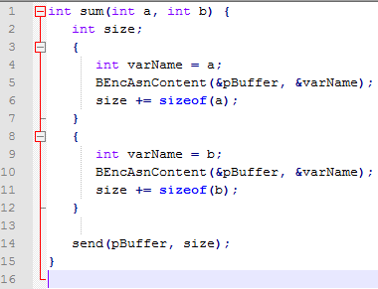
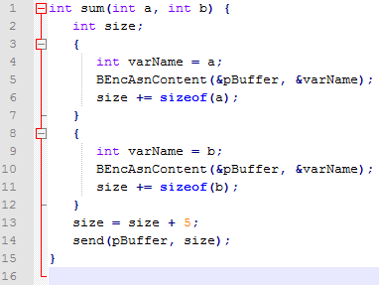
Four-way merging
Synchronization strategy:
Differences filter: A difference is valid if the affected code line is in the Match set or none.
Match = {(1,1), (2,2)..(12,12),(14,14)}

Slide 13
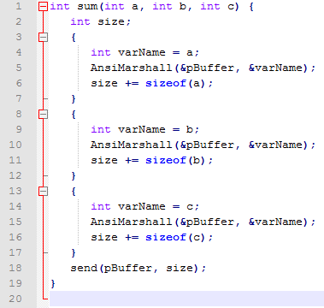
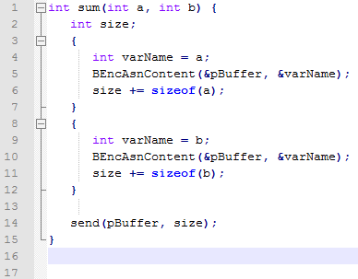
Four-way merging
Synchronization strategy:
Differences filter: A difference is valid if the affected code line is in the Match set or none.
Match = {(1,1), (2,2)..(12,12),(14,14)}
Diff1 = {UPDATE[(1,1), (5,5), (10, 10)], ADD[13, 14, 15, 16, 17]}

Slide 14
Four-way merging
Synchronization strategy:
Differences filter: A difference is valid if the affected code line is in the Match set or none.
Match = {(1,1), (2,2)..(12,12),(14,14)}
Diff1 = {UPDATE[(1,1), (5,5), (10, 10)], ADD[(none,13), (none,14), (none,15), (none,16), (none,17)]}
Diff2 = {ADD[(none,13)]}

Slide 15
Four-way merging
Synchronization strategy:
Differences filter: A difference is valid if the affected code line is in the Match set or none.
Match = {(1,1), (2,2)..(12,12),(14,14)}
Diff1 = {UPDATE[(1,1), (5,5), (10, 10)], ADD[(none,13), (none,14), (none,15), (none,16), (none,17)]}
Diff2 = {ADD[(none,13)]}
Find conflicts:
No conflicts are found in this case
No conflict resolution policy is needed
Merge: apply all differences (Diff1 and Diff2) to the code C
UPDATE(1,1)
UPDATE(5,5)
UPDATE(10,10)
ADD

